Slide 1
Chapter 21. Network Layer: Address Mapping, Error Reporting, and Multicasting
21.1 Address Mapping
21.2 ICMP
21.3 IGMP
21.4 ICMPv6

Slide 2
Address Resolution Protocol (ARP)
Two levels of addresses: Physical address (local address: MAC address) and Logical address (network address: IP address)
Need to be able to map an IP address to its corresponding MAC address
Two types of mapping : static and dynamic
Static mapping has some limitations and overhead against network performance
Dynamic mapping: ARP and RARP
ARP: mapping IP address to a MAC address
RARP (replaced by DHCP): mapping a MAC address to an IP address

Slide 3
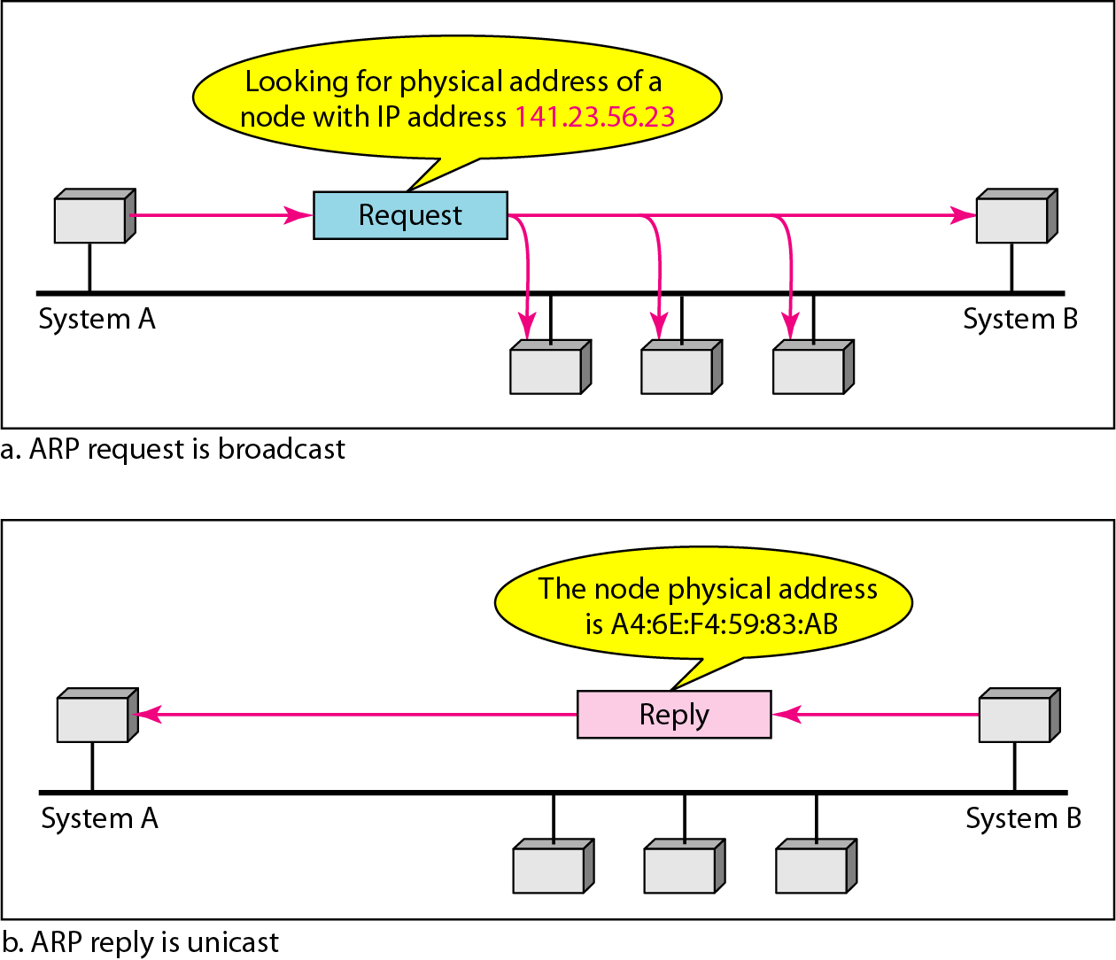
ARP operation
ARP associates an IP address with its MAC addresses
An ARP request is broadcast; an ARP reply is unicast.

Slide 4
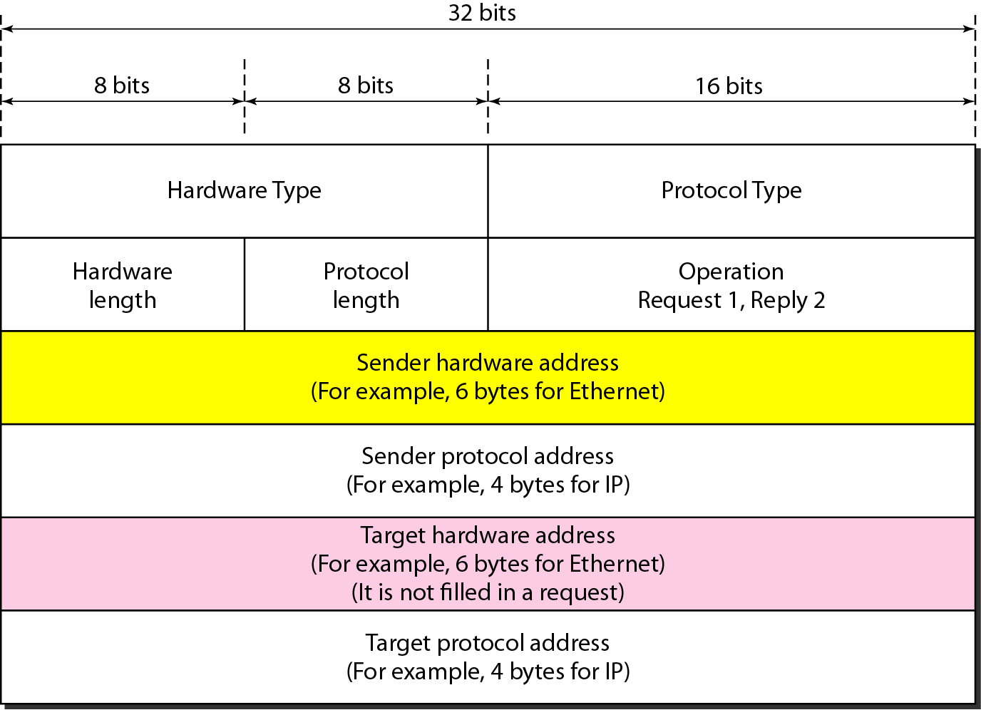
ARP Packet Format
Protocol Type: 0800 for IPv4, Hardware length: 6 for Ethernet, Protocol length: 4 for IPv4

Slide 5
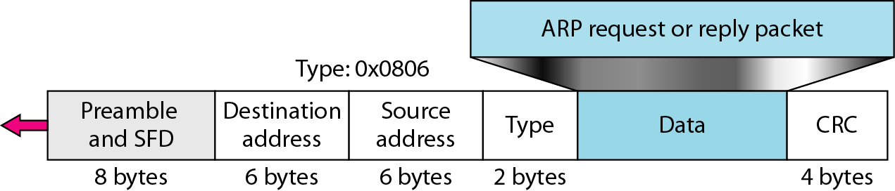
Encapsulation of ARP packet
ARP packet is encapsulated directly into a data link frame (example: Ethernet frame)

Slide 6
ARP Operation
The sender knows the IP address of the target
IP asks ARP to create an ARP request message
The message is encapsulated in a frame (destination address = broadcast address)
Every host or router receives the frame. The target recognizes the IP address
The target replies with an ARP reply message (unicast with its physical address)
The sender receives the reply message knowing the physical address of the target
The IP datagram is now encapsulated in a frame and is unicast to the destination

Slide 7
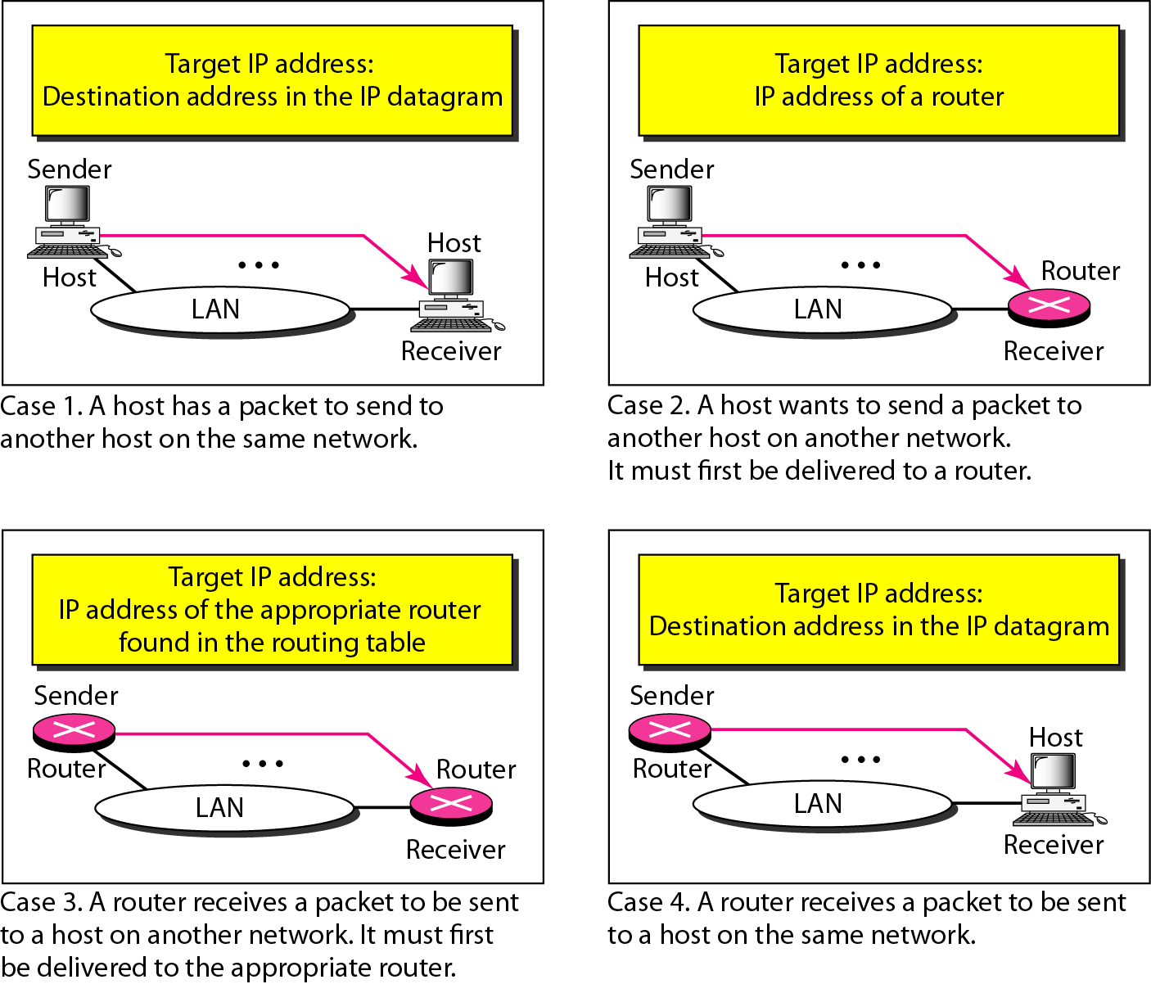
Four different cases using ARP

Slide 8
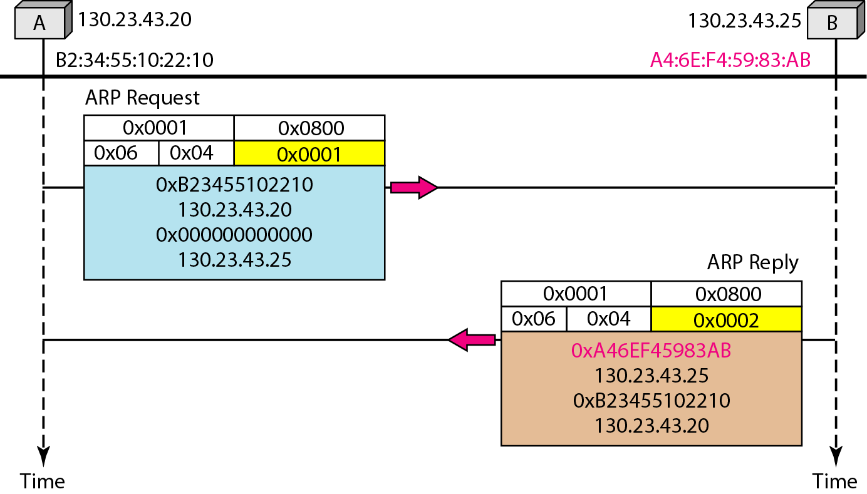
ARP: Example

Slide 9
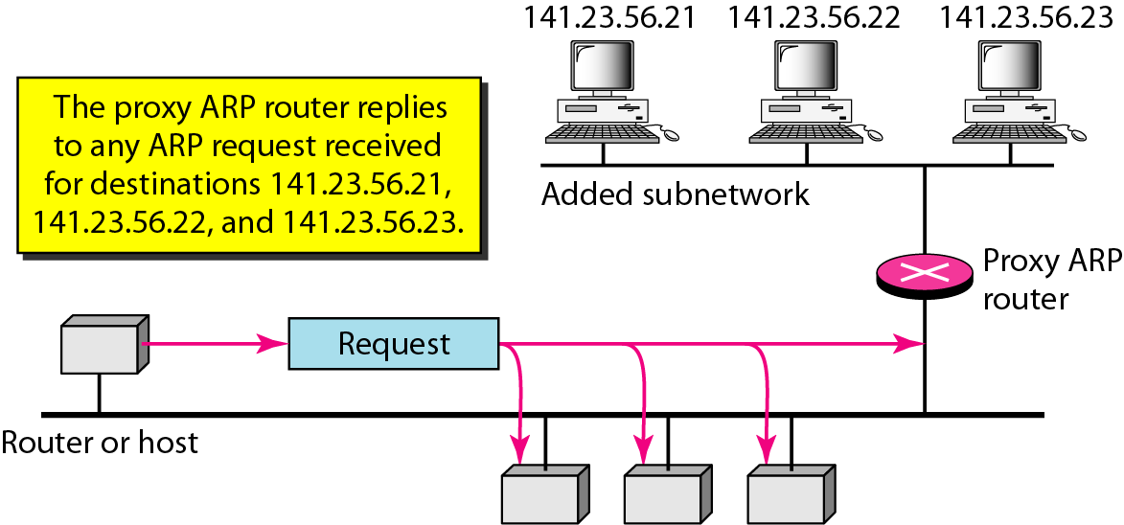
Proxy ARP
A technique used to create a subnetting effect
An ARP that acts on behalf of a set of hosts

Slide 10
Mapping Physical to Logical Address
RARP, BOOTP, and DHCP
RARP(Reverse ARP): serious problem due to broadcasting at the data link layer. RARP server required for each network or subnet.
BOOTP and DHCP are replacing RARP
BOOTP(Bootstrap Protocol) is a client/server protocol designed to provide physical address to logical address mapping
BOOTP is an application layer protocol
BOOTP is not a dynamic configuration protocol
DHCP(Dynamic Host Configuration Protocol) provides static and dynamic address allocation that can be manual or automatic

Slide 11
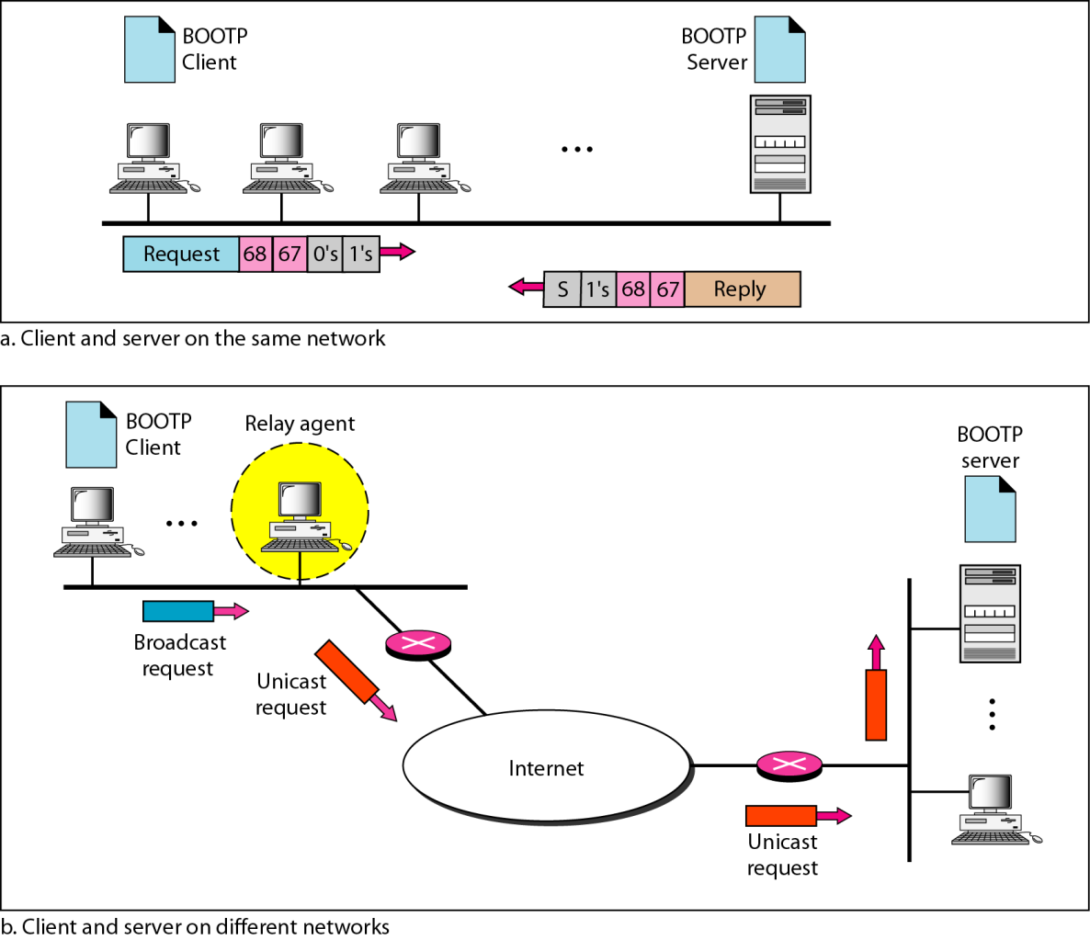
BOOTP Client and Server

Slide 12
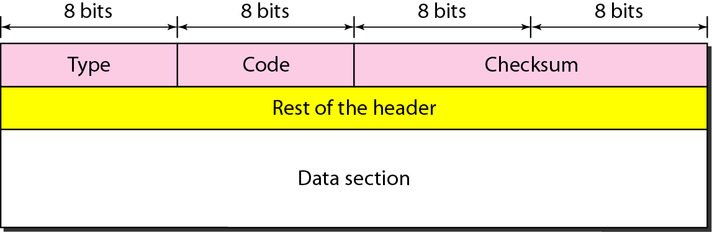
ICMP
IP has no error-reporting or error-correcting mechanism
IP also lacks a mechanism for host and management queries
Internet Control Message Protocol (ICMP) is designed to compensate for two deficiencies, which is a companion to the IP
Two types messages: error-reporting messages and query messages

Slide 13
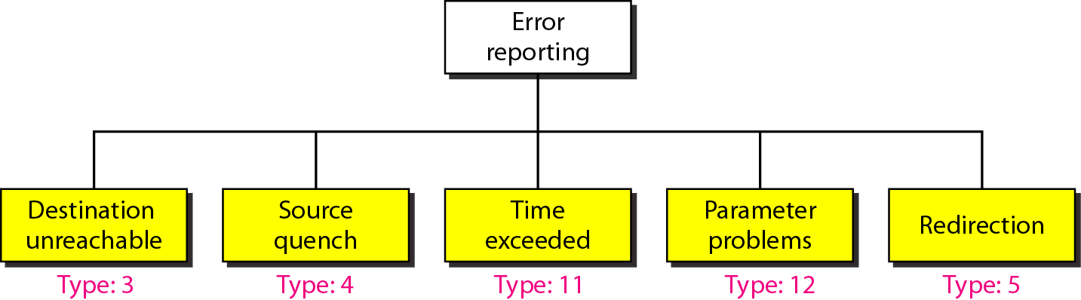
Error Reporting
ICMP always reports error messages to the original source.
Source quench: There is no flow control or congestion control mechanism in IP.
Time exceed: (1) TTL related, (2) do not receive all fragments with a certain time limit
Redirection: To update the routing table of a host

Slide 14
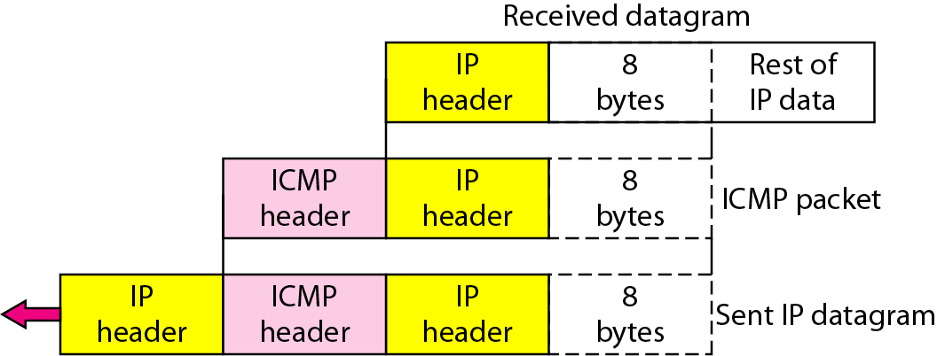
ICMP Error Messages
Important points about ICMP error messages:
No ICMP error message will be generated in response to a datagram carrying an ICMP error message
No ICMP error message will be generated for a fragmented datagram that is not the first fragment
No ICMP error message will be generated for a datagram having a multicast address
No ICMP error message will be generated for a datagram having a special address such as 127.0.0.0 or 0.0.0.0.

Slide 15
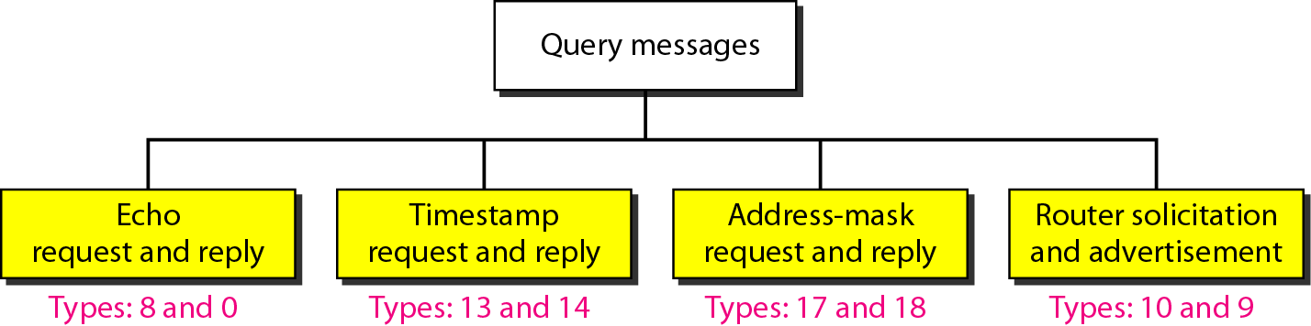
Query messages
To diagnose some network problems
A node sends a message that is answered in a specific format by the destination node
Echo for diagnosis; Time-stamp to determine RTT or synchronize the clocks in two machines; Address mask to know network address, subnet address, and host id; Router solicitation to know the address of routers connected and to know if they are alive and functioning

Slide 16
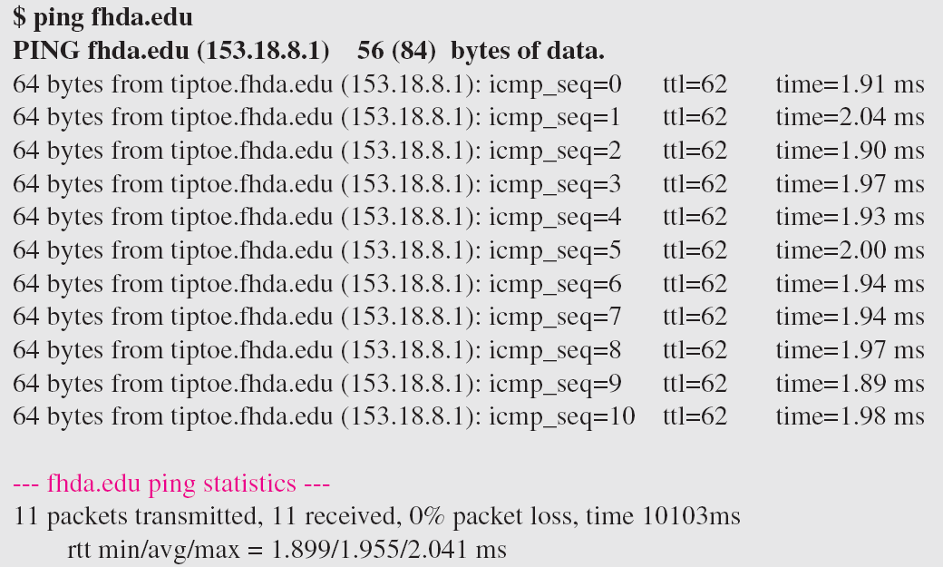
Debugging Tools
Two tools that use ICMP for debugging or tracing the route of a packet: ping and traceroute
Ping: ICMP echo-request message and echo-reply message

Slide 17
Debugging Tools: Traceroute
Traceroute program in UNIX or tracert in Windows can be used to trace the route of a packet from the source to the destination

Slide 18
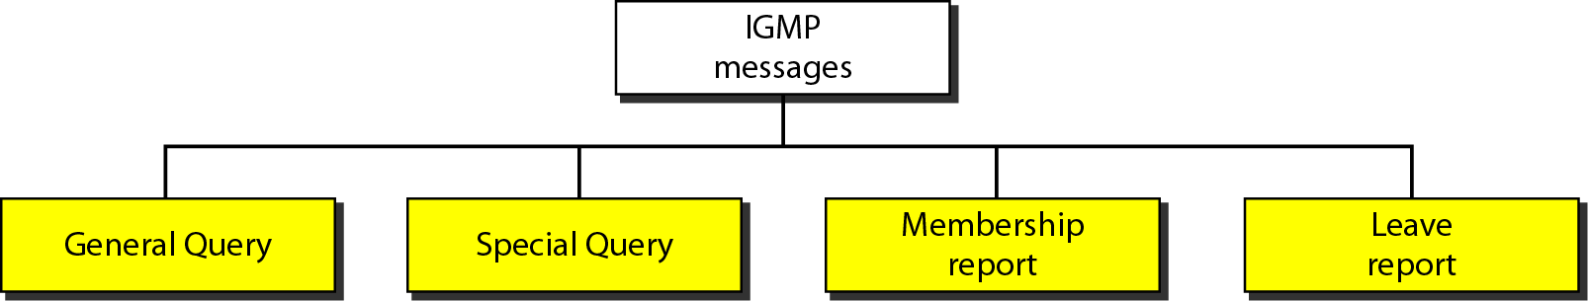
IGMP
Internet Group Management Protocol (IGMP) is one of the necessary, but not sufficient, protocol for multicasting.
IGMP is a companion to the IP protocol
IGMP is a group management protocol. It helps a multicast router create and update a list of loyal members related to each router interface

Slide 19
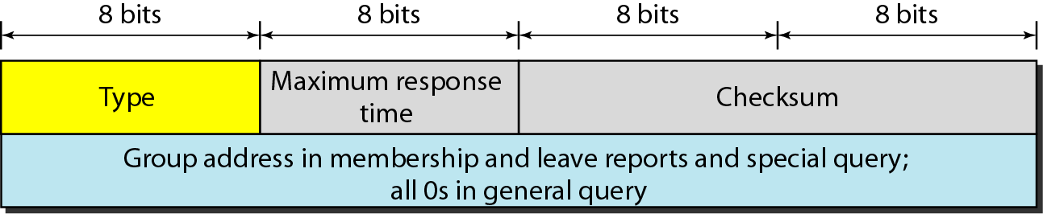
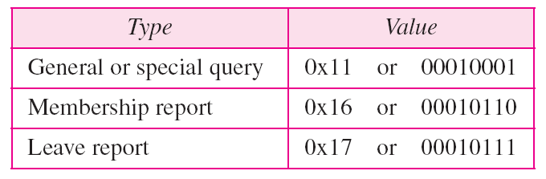
IGMP Message Format

Slide 20
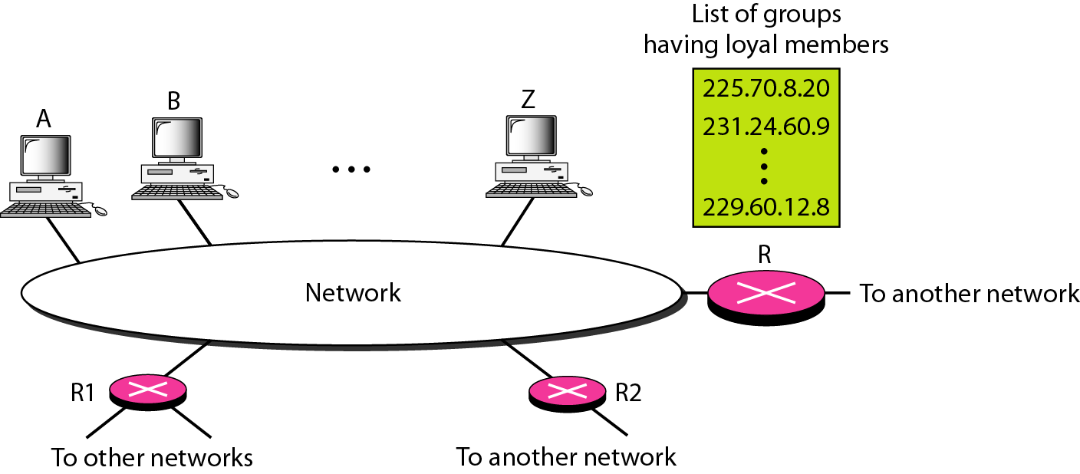
IGMP Operation
Joining a group
In IGMP, a membership report is sent twice, one after the other
Leaving a group
Monitoring membership
The general query message does not define a particular group

Slide 21
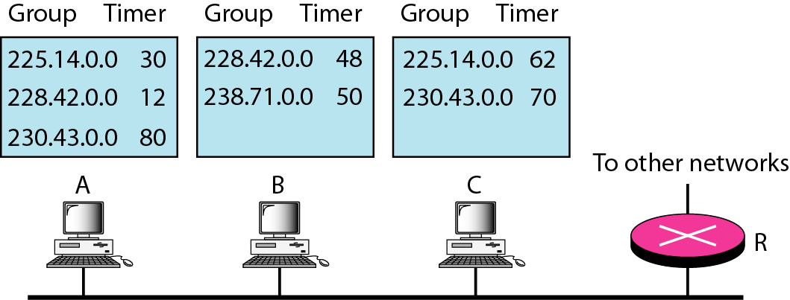
IGMP: Delayed Response
To prevent unnecessary traffic, IGMP uses a delayed response strategy
Example:
Time 12: The timer for 228.42.0.0 in host A expires, and a membership report is sent, which is received by the router and every host including host B which cancels its timer for 228.42.0.0.
Time 30: The timer for 225.14.0.0 in host A expires, and a membership report is sent which is received by the router and every host including host C which cancels its timer for 225.14.0.0.
Time 50: The timer for 238.71.0.0 in host B expires, and a membership report is sent, which is received by the router and every host.

Slide 22
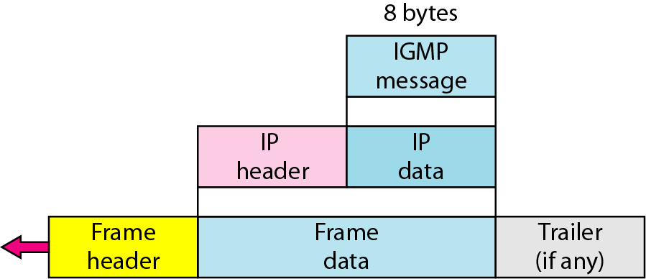
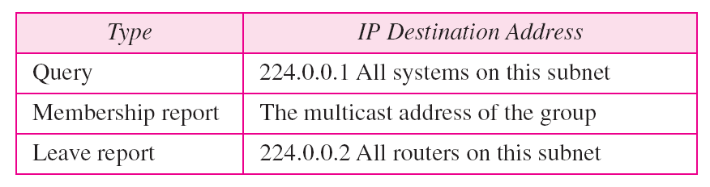
IGMP: Encapsulation at Network Layer
IP encapsulation
The IP packet that carries an IGMP packet has a value of 1 in its TTL field

Slide 23
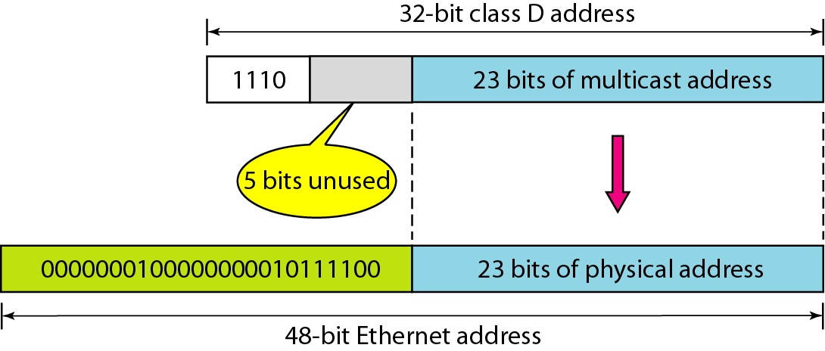
IGMP: Encapsulation at Data Link Layer
ARP cannot find the corresponding MAC (physical) address to forward the packet at the data link layer because the IP packet has a multicast IP address
Mapping class D to Ethernet physical address
An Ethernet multicast physical address is in the range
01:00:5E:00:00:00 to 01:00:5E:7F:FF:FF
Most WAN do not support physical multicast address. To send a multicast packet through these networks, tunneling is used.

Slide 24
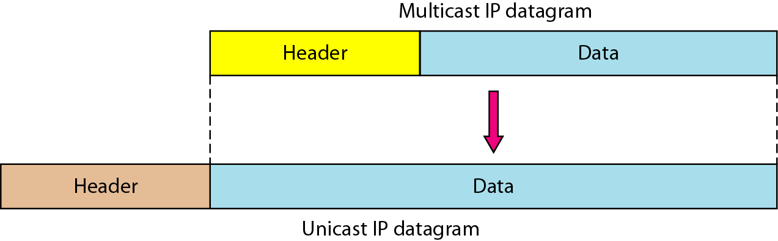
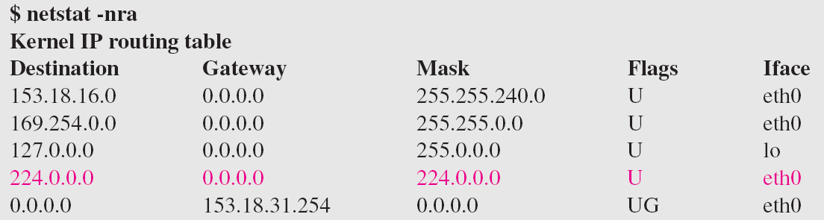
IGMP: Tunneling
Most WAN do not support physical multicast address. To send a multicast packet through these networks, tunneling is used.
Netstat utility can be used to find the multicast addresses supported by an interface

Slide 25
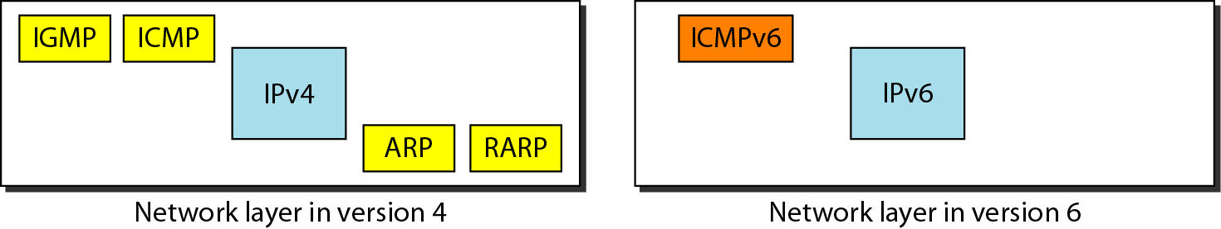
ICMPv6

Slide 26
ICMPv6
Comparison of query messages in ICMPv4 and ICMPv6

